Slide 1

MIT WORLD PEACE UNIVERSITY
Internship Progress Presentation
DevOps Internship at Arixel Technologies
DevOps · DevSecOps · CI/CD · Docker · GitLab · Disaster Recovery · Security Scanning
Student
Industrial Mentor
Renish Lale
Mr. Vinay Sabnis
Contact : 7744035488
Faculty Mentor
Company
Prof. Yogesh Gaikwad
Arixel Technologies

Slide 2
Table of Contents
01
02
03
Objectives of the Internship Program
Company Introduction
Our Role in the Company
04
05
06
Internship Action Plan
Project Overview
Project Modules & Technology Stack
07
08
09
Key Learnings
Key Suggestions from Mentors
Action Plan for Remaining Period

Slide 3
Objectives of the Internship Program
Defining Goals for a Productive Industry Experience
Practical DevOps Experience
Containerisation
Project Management Workflows
Gain hands-on exposure to DevOps and DevSecOps workflows used in real industry environments.
Learn Docker, container images, and container-based deployment methodologies.
Understand software development lifecycle management using GitLab, Jira, and Zoho Projects.
Professional Skills
CI/CD Automation
Applied Industry Project
Improve problem-solving, teamwork, technical communication, and documentation capabilities.
Learn GitLab CI/CD pipeline creation, configuration, and troubleshooting.
Apply theoretical knowledge to build an industry-oriented DevSecOps platform.
Application Security
Understand security integration through tools such as SonarQube, Fortify, Checkmarx, and Veracode.

Slide 4
Company Introduction
Arixel Technologies
Arixel Technologies is a technology organisation focused on delivering modern software and IT solutions. The company works with technologies spanning software development, DevOps practices, and cloud-based services.
Core Focus Areas
Software Development & IT Solutions
DevOps & DevSecOps Engineering
Cloud Infrastructure & Automation
Application Security & Compliance
Containerisation & Deployment
🌐 Domain
💼 Nature
🔧 Speciality
🏢 Internship
Software & Technology Services
IT Solutions & Engineering
DevOps, DevSecOps, Cloud
Industry-Oriented Project Exposure
📍 Engagement
Professional Technical Internship

Slide 5
My Role in the Company
Position: DevOps Intern | Arixel Technologies
⚙ DevOps Tools
🛡 DevSecOps
Learned Jenkins, GitLab, Zoho Projects, and Jira for managing development workflows.
Understood DevSecOps principles and how security integrates into software delivery pipelines.
🔀 GitLab & CI/CD
🐳 Docker
Explored GitLab repositories, branches, commits, pipelines, runners, and CI/CD automation.
Learned Docker, container images, containerisation, and container-based deployment.
🔒 Application Security
🏗 Project Work
Studied Fortify, SonarQube, Checkmarx, and Veracode for application security scanning.
Created an Enterprise DevSecOps Disaster Recovery & Deployment Platform as the internship project.

Slide 6
Internship Action Plan
Weekly Learning Milestones | June 2026 – July 2026
Week 1 | 3rd – 7th June
1
Introduced to project management tools such as Jenkins, GitLab, Zoho Projects, and Jira, and learned their basic features and uses.
2
Week 2 | 8th – 14th June
Prepared and delivered presentations explaining various project management tools to improve understanding and communication.
Week 3 | 15th – 21st June
3
Studied application security tools and gained an understanding of their role in software security.
4
Week 4 | 22nd – 28th June
Created presentations and explored application security concepts through practical discussions.
Week 5 | 29th June – 5th July
5
Learned the fundamentals of DevSecOps and its importance in secure software development.
6
Week 6 | 6th – 12th July
Followed the GitLab learning roadmap. Learned GitLab basics and CI/CD concepts.
Week 7 | 13th – 17th July
7
Successfully created GitLab projects and initiated CI/CD pipelines.

Slide 7
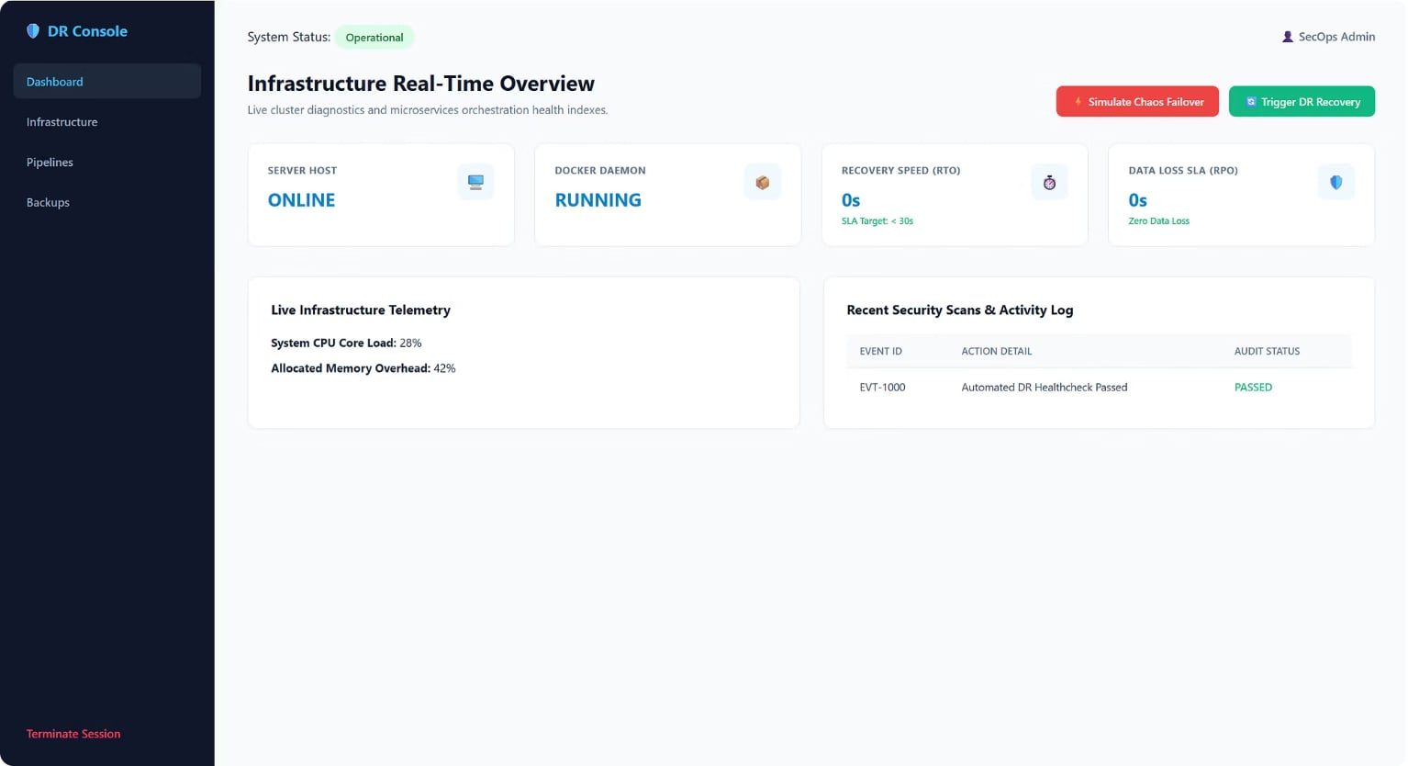
Project Overview
Enterprise DevSecOps Disaster Recovery & Deployment Platform
⚠ Problem Statement
Organizations require a reliable, centralized method to monitor infrastructure health, manage backups, track CI/CD deployments, and respond rapidly to system failures — all within a unified operational view.
✅ Our Solution
A web-based platform providing a centralized dashboard for infrastructure monitoring, GitLab CI/CD pipeline tracking, automated backup management, and disaster recovery workflows — enabling faster response and recovery.
Platform Workflow: Infrastructure Monitoring → CI/CD Pipeline Tracking → Backup Management → Failover Simulation → Recovery Monitoring → RTO / RPO Analysis
Each stage of the platform is independently operable, providing end-to-end visibility from infrastructure health through to recovery verification and performance metrics.
#DEVOPS
#DEVSECOPS
#GITLAB CI/CD
#DOCKER
#DISASTERRECOVERY
#CONTAINERISATION

Slide 8
Project Modules & Technology Stack
Functional Modules and Implementation Technologies
Project Modules
Technology Stack
🖥 Infrastructure Hub
🔀 GitLab Pipeline Monitoring
Frontend
Backend
Node visibility — roles, IPs, CPU load, and live system status.
HTML5 · CSS3 · JavaScript
Node.js · Express.js
Pipeline ID, project, branch, status, and direct links.
DevOps / VCS
💾 Data Backup Orchestration
♻ Disaster Recovery
Git · GitLab · GitLab CI/CD
Chaos/failover simulation, recovery workflow, and health monitoring.
Backup schedules, retention policy, volume snapshots, and status.
📊 RTO / RPO Monitoring
📋 Activity & Recovery Logs
Real-time tracking of Recovery Time Objective and Recovery Point Objective.
Detailed recovery activity logs and event audit trail.

Slide 9
Key Learnings
Technical and Professional Skills Developed During the Internship
⚙ DevOps Workflows
🖥 Infrastructure Monitoring
🔀 GitLab & CI/CD
Practical understanding of DevOps principles, tools, and end-to-end delivery pipelines.
Monitoring node health, CPU load, system status, and infrastructure visibility.
Repository management, branching strategies, commit workflows, CI/CD pipeline creation, and GitLab Runners.
♻ Disaster Recovery
🔒 Application Security
📋 Documentation & Communication
Chaos simulation, failover workflows, RTO/RPO concepts, and recovery monitoring.
Conceptual understanding of Fortify, SonarQube, Checkmarx, and Veracode for secure software development.
Technical documentation, presentation preparation, and professional workplace communication.
🛡 DevSecOps Principles
🧩 Problem-Solving
🐳 Docker & Containers
Integration of security into DevOps workflows — security scanning, dependency checks, and secret detection.
Debugging pipeline configurations, resolving environment issues, and applying logical troubleshooting.
Docker basics, container images, containerisation concepts, and container-based deployment strategies.

Slide 10
Key Suggestions from Mentors
Professional Guidance Received During the Internship Period
Solve Real Industrial Problems
Focus on understanding practical industrial challenges and develop solutions that address genuine operational needs rather than academic exercises.
Understand Tools In Depth
Go beyond basic usage — understand how tools work internally, their configuration options, limitations, and best practices.
Follow Secure Development Practices
Integrate security at every phase of development. Adopt DevSecOps principles and ensure code, dependencies, and secrets are managed securely.
Maintain Technical Documentation
Document every process, configuration, and decision. Good documentation enables collaboration and knowledge transfer.
Automate Repetitive Workflows
Identify and automate manual, repetitive processes using CI/CD pipelines, scripts, and infrastructure-as-code approaches.
Build Scalable and Maintainable Solutions
Design platforms and systems with scalability and maintainability in mind so they can evolve without requiring complete rewrites.
Continue Learning Modern Technologies
Continuously develop skills in DevOps, DevSecOps, cloud infrastructure, container orchestration, and related modern technologies.

Slide 11
Conclusion
Gained hands-on experience in real-world DevOps and DevSecOps workflows.
Learned GitLab, Docker, Jenkins, CI/CD, and application security tools.
Developed the Enterprise DevSecOps Disaster Recovery & Deployment Platform.
Improved debugging, troubleshooting, and analytical thinking through practical tasks.
Enhanced teamwork, communication, presentation, and documentation skills.
Understood secure software development and modern deployment practices.
Built confidence to work on real-world DevOps and cloud-based projects.
This internship strengthened my technical foundation and prepared me for future industry challenges.

